Slide 1

Introduction
Reusability is an important feature of OOPC. C++ strongly supports the concept of reusability.
Reusing existing code saves time and money and increases a program’s reliability
The mechanism of deriving a new class from an old one is called inheritance /derivation / extending classes.
The old class is referred to as base class/superclass/parent class. The new class is called the derived class /subclass/child class.

Slide 2
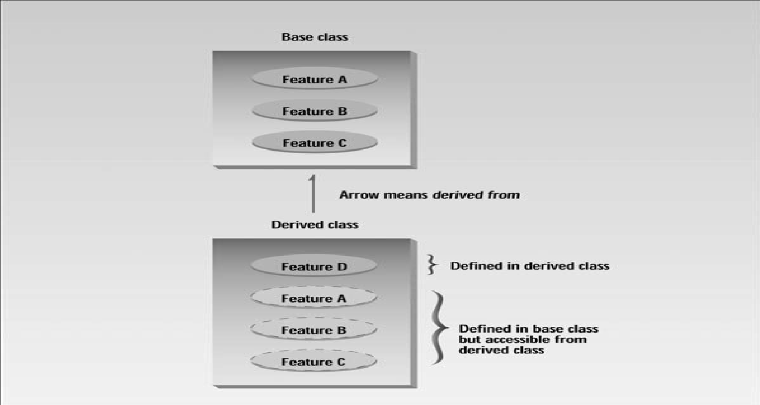
Introduction
The derived class inherits some or all of the traits from the base class.

Slide 3
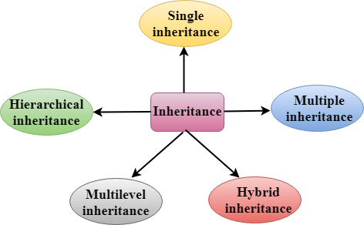
Types of Inheritance

Slide 4
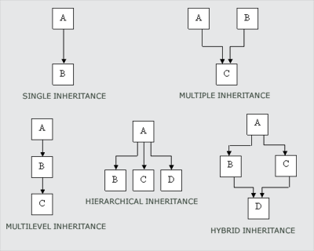
Types of Inheritance

Slide 5
Types of Inheritance
Single inheritance: process of deriving a class from only one base class
Multilevel Inheritance: process of deriving a class from another derived class
Multiple Inheritance: process of deriving a class from two or more base classes.
Hierarchical Inheritance: process of deriving more than one class from a one base class.
Hybrid Inheritance: combination of more than one type of inheritance.

Slide 6
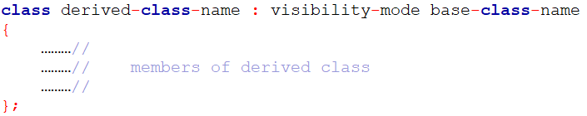
Defining Derived Classes
A derived class can be defined by specifying its relationship with the base class in addition to its own details.
The colon indicates that the derived-class-name is derived from the base-class-name
The visibility mode is optional and , if present, may be either private or public.
The default visibility mode is private.
Visibility mode specifies whether the features of the base class are derived privately or publicly.
Prepared By: Prof. Nishat Shaikh & Dr. Aayushi Chaudhari

Slide 7
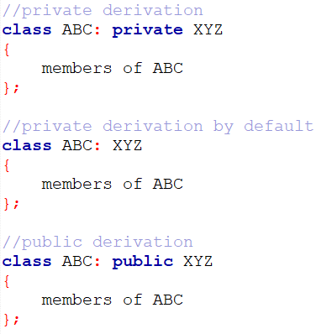
Defining Derived Classes

Slide 8
Making Private Member Inheritable
Private member of a base class cannot be accessible in derived class directly.
By modifying the visibility limit of the private member to public would make it accessible to all the other functions of the program, thus taking away the advantage of data hiding.

Slide 9
Making Private Member Inheritable
C++ provides a third visibility modifier, protected, which is accessible by the member functions within its class and any class immediately derived from it.
It can not be accessed by the functions outside these two classes.

Slide 10
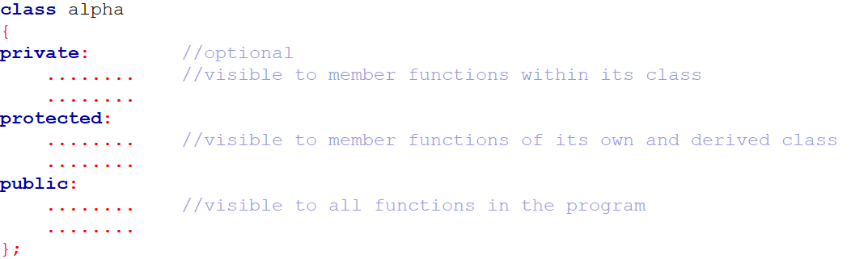
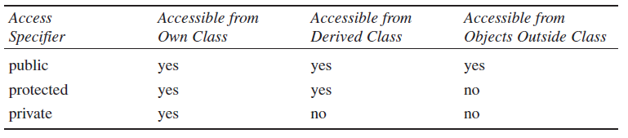
Inheritance and Accessibility

Slide 11
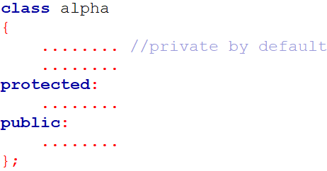
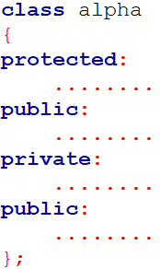
Making Private Member Inheritable
The keywords private, protected and public may appear in any order and any number of times.
However, the normal practice is to use them as follows:
NOTE: It is also possible to inherit base class in protected mode (known as protected derivation)

Slide 12
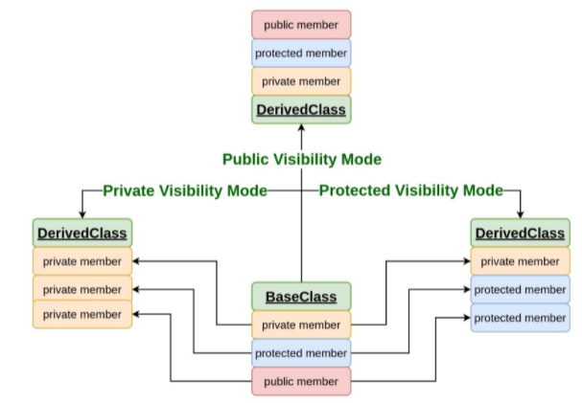
Effect of inheritance on visibility of members

Slide 13
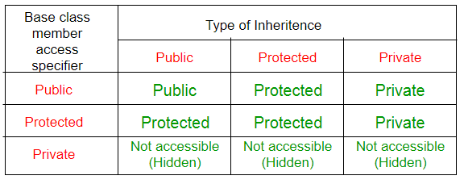
Visibility of inherited members
Note: A derived class doesn’t inherit access to private data members. However, it does inherit a full parent object, which contains any private members which that class declares.

Slide 14
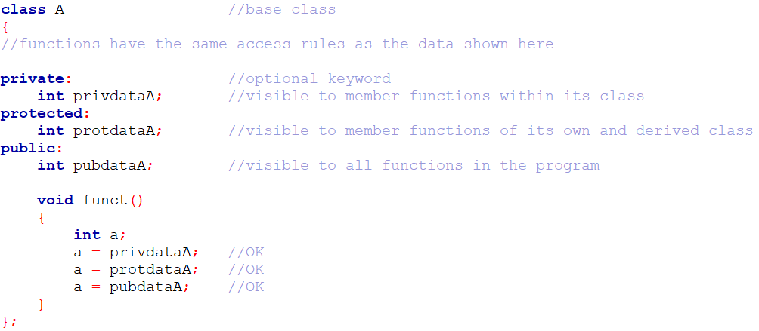

Slide 15
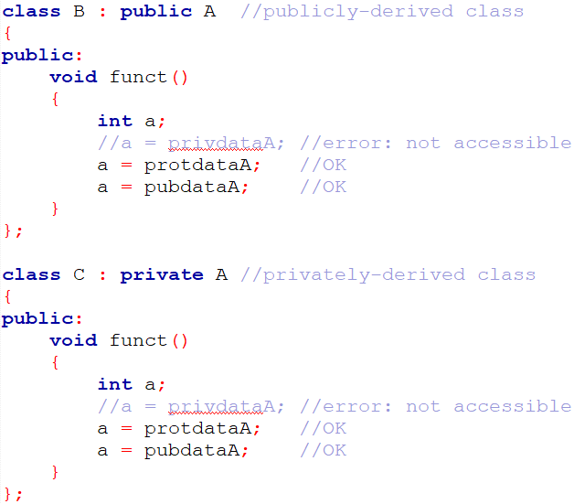
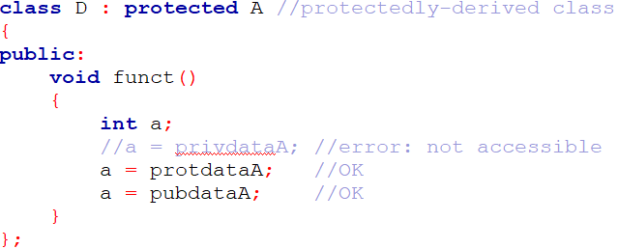

Slide 16
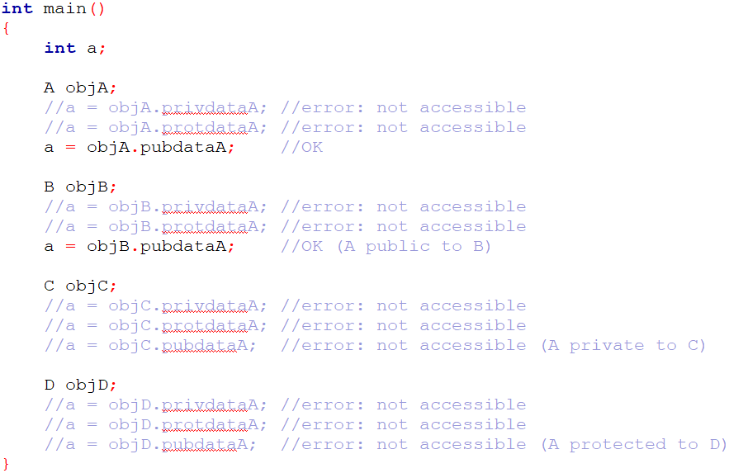

Slide 17
Access Control to Data Members
Functions that can have access to the private and protected members of a class:
A function that is a friend of the class.
A member function of a class that is a friend of the class.
A member function of a derived class.

Slide 18
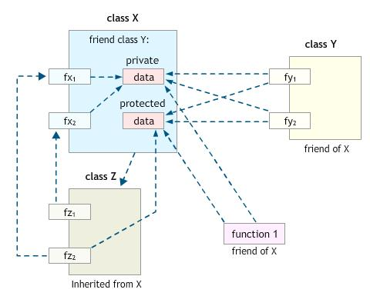
Access Control to Data Members

Slide 19
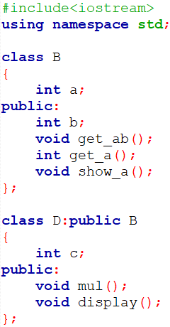
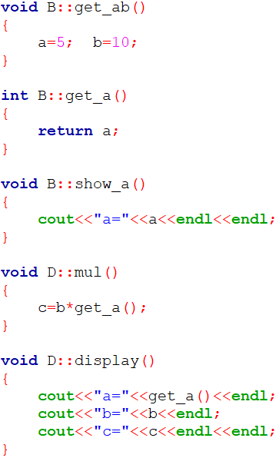
Single inheritance: public derivation

Slide 20
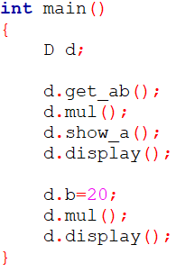

Single inheritance: public derivation

Slide 21
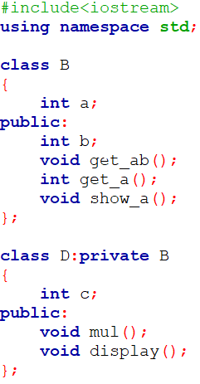
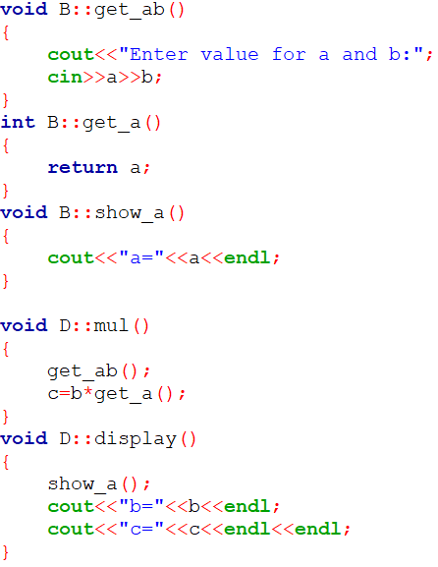
Single inheritance: private derivation

Slide 22
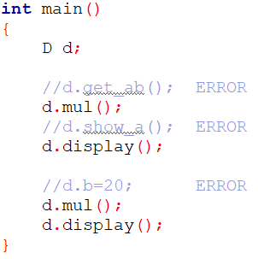
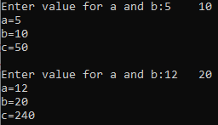
Single inheritance: private derivation

Slide 23
Practical :Single Inheritance
Define a Base Class Vegetable having data member Color and member function getdata() which takes color as an input and putdata() which print the color as an output. Vegetable Class has one subclass named Tomato having data members weight and size and member function gtdata() which takes weight and size as an input and ptdata() which prints weight and size as output. Write a C++ Program which inherits the data of Vegetable class in Tomato class using Single Inheritance.

Slide 24
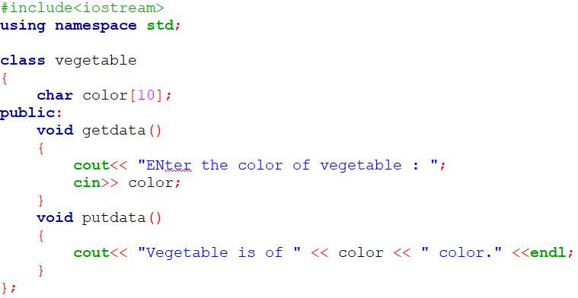
Practical :Single Inheritance

Slide 25
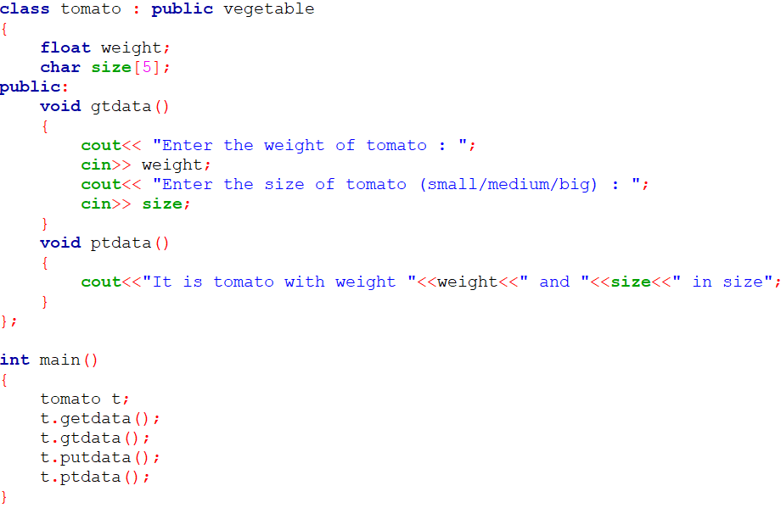

Practical :Single Inheritance

Slide 26
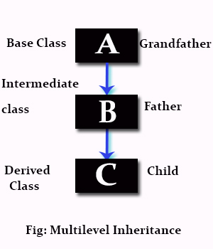
Multilevel inheritance
The class A serves as a base class for the derived class B, which in turn serves as a base class for the derived class C.
The class B is known as intermediate base class since it provides a link for the inheritance between A and C.
The chain ABC is known as inheritance path.
NOTE: The process can be extended to any number of levels

Slide 27
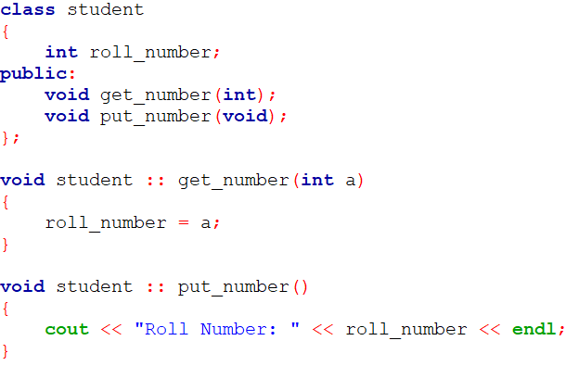
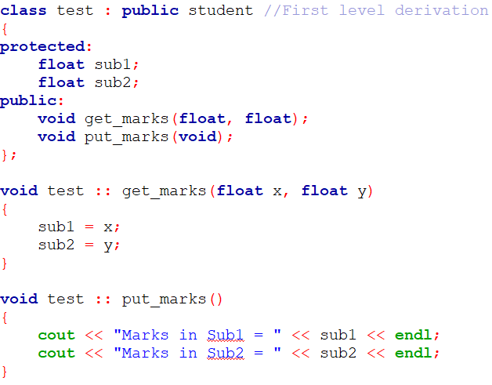
Multilevel inheritance

Slide 28
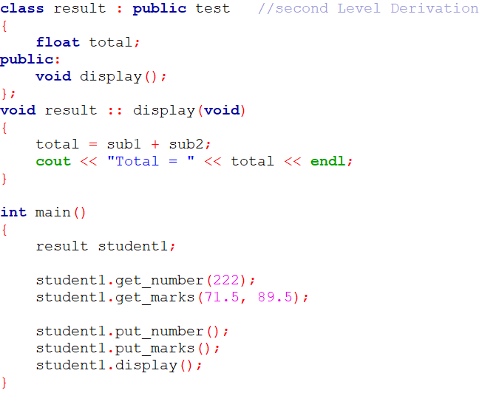

Multilevel inheritance

Slide 29
Practical : Multilevel Inheritance
Create a class shape having data member shape_name and member function to get and print shape_name. Derive a Class Circle which is inherited publicly from class shape and having data members radius of a circle and member function to get and print radius of a circle. Derive a Class Area which is inherited publicly from Class Circle and having data members area_of_circle and member function display () which displays area of a circle. Use object of class Area in main () function and get and display all the information.
Use the concepts of Multilevel Inheritance.

Slide 30
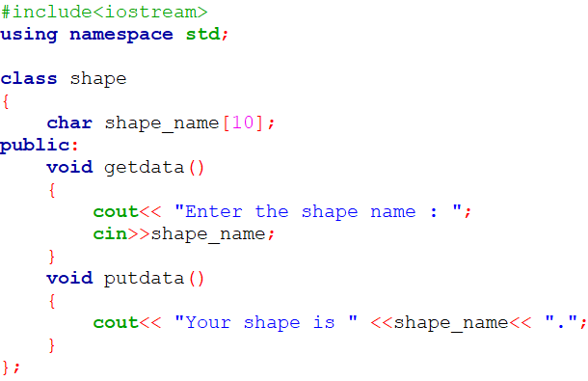
Practical : Multilevel Inheritance

Slide 31
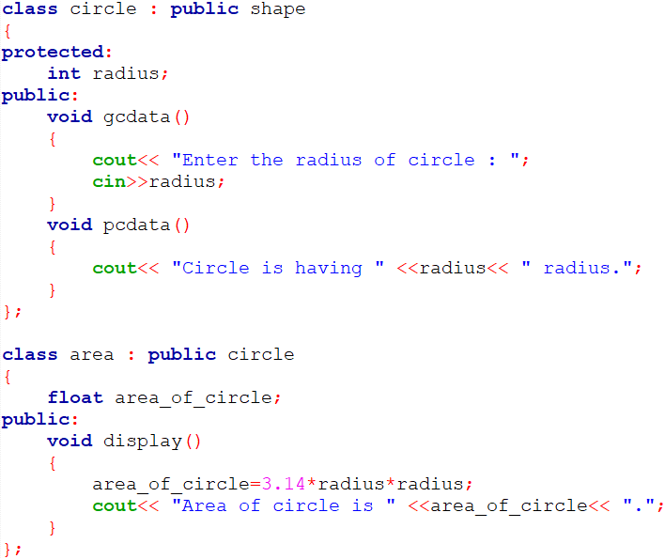
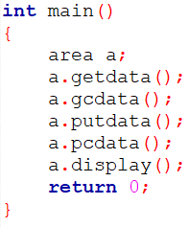
Practical : Multilevel Inheritance

Slide 32

Multiple Inheritance
A class can inherit the attributes of two or more classes is known as multiple inheritance.
It allows us to combine the features of several existing classes as a starting point for defining new classes.
It is like a child inheriting the physical features of one parent and the intelligence of another.

Slide 33
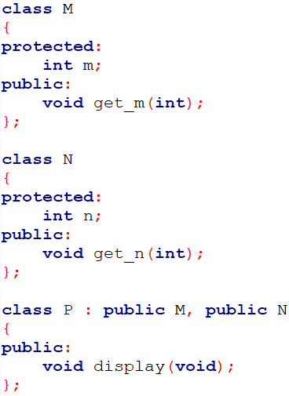
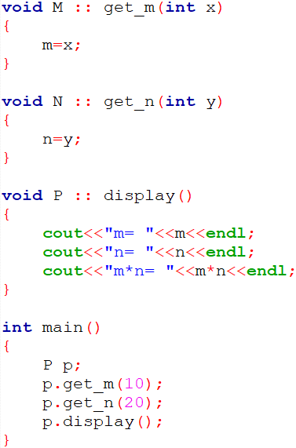

Multiple Inheritance

Slide 34
Ambiguity Resolution in Inheritance
Ambiguity may arise in inheritance application, when the function in derived class overrides the inherited function.
A call to function with same name in base class and derived class by derived class object will invoke function defined in derived class only.
However, we may invoke the function defined in base class by using the scope resolution operator.

Slide 35
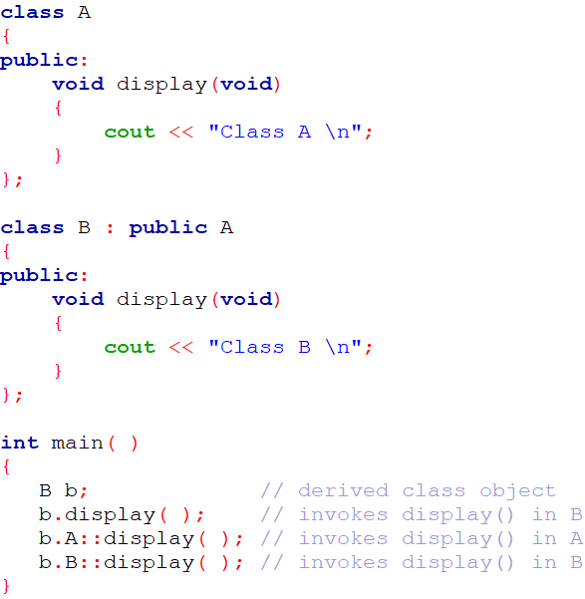

Ambiguity Resolution in Inheritance
In Single Inheritance

Slide 36
Ambiguity Resolution in Inheritance
We may also face a problem in using the multiple inheritance, when a function with the same name appears in more than one base class.
We can solve this problem by defining a named instance within derived class, using the class resolution operator with the function.

Slide 37
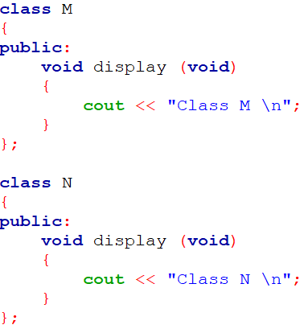
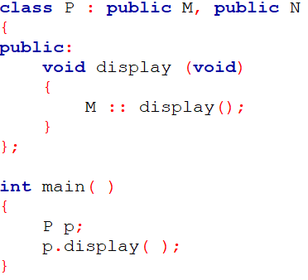
Ambiguity Resolution in Inheritance
In Multiple Inheritance

Slide 38
Constructors in Derived Classes
We know that constructor is invoked implicitly when an object is created
In inheritance, when we create object of derived class, what will happen?
Unit 8: Inheritance

Slide 39
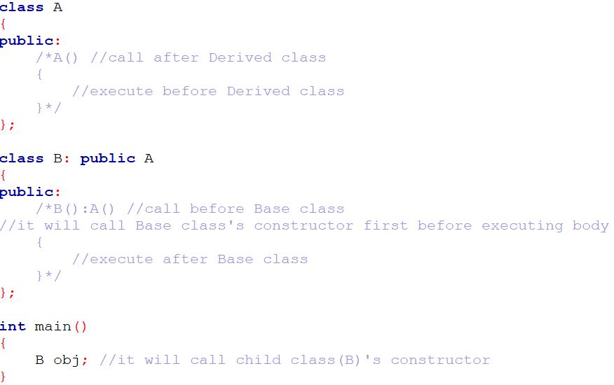
Constructors in Derived Classes
Compiler’s Default Constructor in case of inheritance

Slide 40
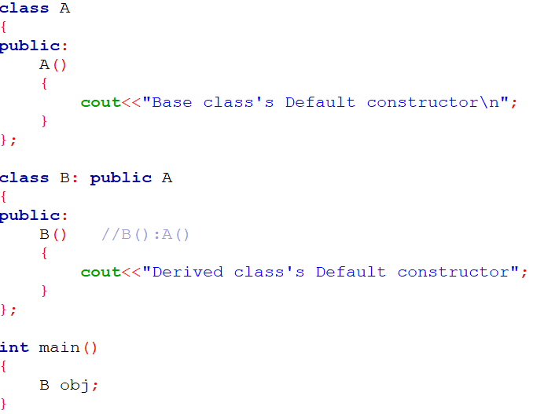

Constructors in Derived Classes
User’s Default Constructor in case of inheritance
Unit 8: Inheritance

Slide 41
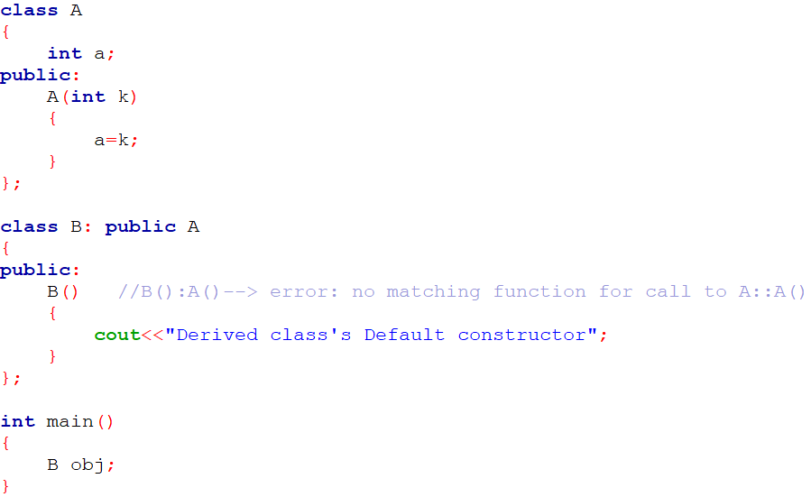
Constructors in Derived Classes
NOTE:
As long as no base class constructor takes any arguments, the derived class need not have a constructor function.
However, if any base class contains a constructor with one or more arguments, then it is mandatory for the derived class to have a constructor, call base class’s constructor explicitly and pass the arguments to the base class constructors.
Unit 8: Inheritance

Slide 42
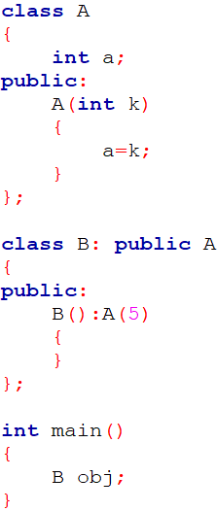
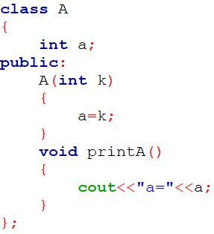
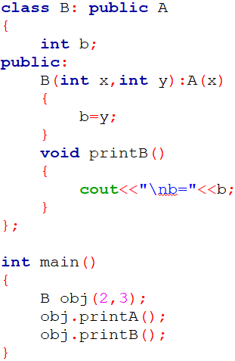

Constructors in Derived Classes
Unit 8: Inheritance

Slide 43
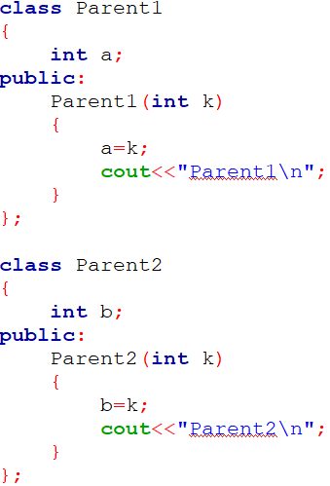
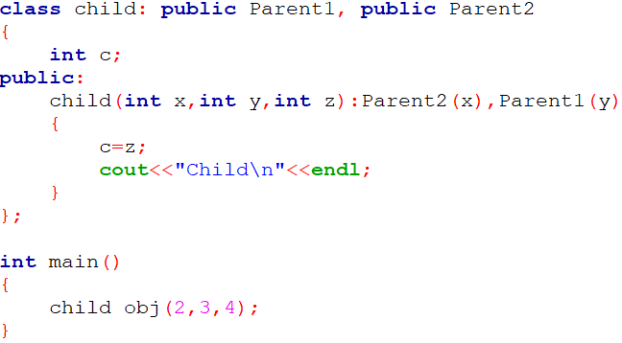

Constructors in Derived Classes
NOTE: In case of multiple inheritance, the base class are constructed in the order in which they appear in the declaration of the derived class.
Unit 8: Inheritance

Slide 44
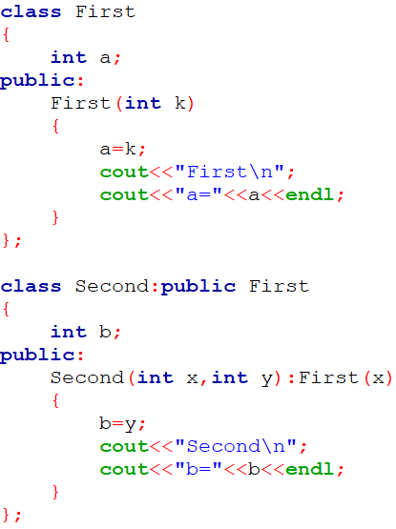
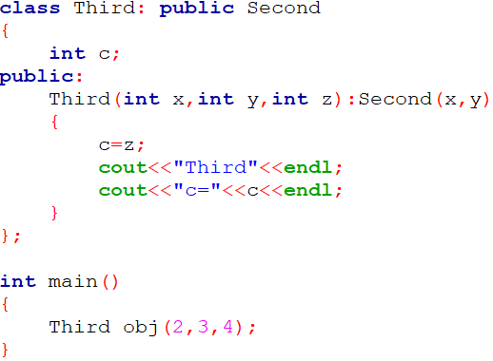

Constructors in Derived Classes
NOTE: In case of multilevel inheritance, the constructors will be executed in the order of inheritance.
Unit 8: Inheritance

Slide 45
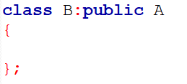
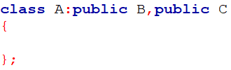

Constructors in Derived Classes
The constructors for virtual base classes are invoked before any non-virtual base classes.
If there are multiple virtual base classes, they are invoked in the order in which they are declared. Any non-virtual bases are then constructed before the derived class constructor is executed.
Method of inheritance | Order of execution
 | A(); base constructor B(); derived constructor
 | B(); base(first) C(); base(second) A(); derived
 | C() ; virtual base B(); ordinary base A(); derived
Unit 8: Inheritance

Slide 46

Constructors in Derived Classes
C++ supports another method of initializing the class objects.
This method uses what is known as initialization list in the constructor function.
We can use initialization-section to provide initial values to the base constructor and also to initialize its own class members.
We can use either/both section(assignment as well as initialization) to initialize the data members of the constructor.
Unit 8: Inheritance

Slide 47
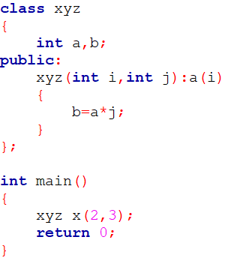
Constructors in Derived Classes
Unit 8: Inheritance
Prepared By: Nishat Shaikh

Slide 48


Destructor in inheritance
Unit 8: Inheritance

Slide 49
Practical : Multiple Inheritance
Create a Class alpha having data member: int x and one argument constructor which initializes the value of x. It also has member function which displays the value of x. Create another class beta which contains data member: float y and one argument constructor which initializes the value of y. It also has member function which displays the value of y. Create a Class Gamma which publicly inherits from class alpha and class beta and has two data members: int m, n and a constructor which passes argument to the base class constructor as well as initializes its own data members. Class Gamma also has member function to print the values of m and n. Write main function which creates object of class Gamma which passes values of base class constructor as well as derived class constructor.
Use the concept of Multiple Inheritance and Constructor in Derived Class.
Unit 8: Inheritance

Slide 50


Practical : Multiple Inheritance
Unit 8: Inheritance

Slide 51



Practical : Multiple Inheritance
Unit 8: Inheritance
Prepared By: Nishat Shaikh

Slide 52


Hierarchical Inheritance
Many Programming problems can be cast into a hierarchy where certain features of one level are shared by many others below that level
The base class will include all the features that are common to the subclasses.
A subclass can be constructed by inheriting the properties of the base class.
A subclass can serve as a base class for the lower level classes and so on
Unit 8: Inheritance
Prepared By: Nishat Shaikh

Slide 53



Hierarchical Inheritance
Unit 8: Inheritance

Slide 54
Practical :Hierarchical Inheritance
Write a program to create a class Medicine which stores type of medicine, name of company, date of manufacturing. Class Tablet is inherited from Medicine. Tablet class has name of tablet, quantity per pack, price of one tablet as members. Class Syrup is also inherited from Medicine and it has quantity per bottle, dosage unit as members. Both the classes contain necessary member functions for input and output data. Write a main( ) that enter data for tablet and syrup, also display the data.
Use the concepts of Hierarchical Inheritance.
Unit 8: Inheritance

Slide 55

Practical :Hierarchical Inheritance
Unit 8: Inheritance
Prepared By: Nishat Shaikh

Slide 56

Practical :Hierarchical Inheritance
Unit 8: Inheritance

Slide 57

Practical :Hierarchical Inheritance
Unit 8: Inheritance

Slide 58


Practical :Hierarchical Inheritance

Slide 59

Hybrid Inheritance
There could be situations where we need to apply two or more types of inheritance.
For instance, consider the following Fig. where result will have both multilevel and multiple inheritance
Unit 8: Inheritance

Slide 60

Hybrid Inheritance
Unit 8: Inheritance

Slide 61



Hybrid Inheritance
Unit 8: Inheritance

Slide 62

Virtual Base Classes
Consider the situation where we have one class Grandparent .This class is inherited by two other classes Parent1 and Parent2. Both these class are inherited into a new class child as shown in figure below.
As we can see from the figure that data members/function of class Grandparent are inherited twice to class child. One through class Parent1 and second through class Parent1.
Unit 8: Inheritance

Slide 63
Virtual Base Classes
When any data / function member of class Grandparent is accessed by an object of class child, ambiguity arises as to which data/function member would be called?
One inherited through Parent1 or the other inherited through Parent2. This confuses compiler and it displays error.
Unit 8: Inheritance

Slide 64

Virtual Base Classes
Unit 8: Inheritance

Slide 65

Virtual Base Classes
To resolve this ambiguity when class Grandparent is inherited in both class Parent1 and class Parent2, it is declared as virtual base class by placing a keyword virtual as :
Note:
virtual can be written before or after the public.
Now only one copy of data/function member will be copied and class Grandparent becomes the virtual base class.
Unit 8: Inheritance
Prepared By: Nishat Shaikh

Slide 66

Virtual Base Classes
NOTE:
When a class is made virtual base class, C++ takes necessary care to see that only one copy of that class is inherited, regardless of how many inheritance path exist between the virtual base class and a derived class
Unit 8: Inheritance
Prepared By: Nishat Shaikh

Slide 67

Virtual Base Classes
Unit 8: Inheritance
Prepared By: Nishat Shaikh

Slide 68



Virtual Base Classes
Unit 8: Inheritance
Prepared By: Nishat Shaikh

Slide 69
Practical : Hybrid Inheritance
Define a class Hospital having rollno and name as data members and member function to get and print data. Derive a class Ward from class Hospital having data members: ward number and member function to get and print data. Derive another class Room from Hospital having data member bed number and nature of illness and member function to get and print data. Derive class Patient from Class Ward and Class Room. In main () declare 5 object of Class Patient and get and display all the information.
Use the concept of Virtual Base Class and Hybrid Inheritance.
Unit 8: Inheritance
Prepared By: Nishat Shaikh

Slide 70

Practical : Hybrid Inheritance
Unit 8: Inheritance
Prepared By: Nishat Shaikh

Slide 71


Practical : Hybrid Inheritance
Unit 8: Inheritance
Prepared By: Nishat Shaikh

Slide 72

Practical : Hybrid Inheritance
Unit 8: Inheritance
Prepared By: Nishat Shaikh

Slide 73
Abstract Classes
An abstract class is one that is not used to create objects.
It is designed only to act as a base class(to be inherited by other classes)
It is a design concept in program development and provides a base upon which other classes may built.
Unit 8: Inheritance
Prepared By: Nishat Shaikh

Slide 74
Member Classes: Nesting of Classes
Is-a relationship: Inheritance is a Is-a relationship
Ex: BMW is-a car [Here, BMW & car are classes]
Has-a relationship: Composition is a Has-a relationship
Ex: Car has-a engine [Here, Car & engine are classes]
What is Nested class?
A nested class is a class that is declared in another class
It implements the concept of “has-a” relationship.
Unit 8: Inheritance
Prepared By: Nishat Shaikh

Slide 75


Member Classes: Nesting of Classes
Syntax 1
Syntax 2
Unit 8: Inheritance
Prepared By: Nishat Shaikh

Slide 76
Member Classes: Nesting of Classes
Defining Nested class inside the Enclosing class
Nested class as private
Nested class as public
Defining Nested class outside the Enclosing class
Unit 8: Inheritance
Prepared By: Nishat Shaikh

Slide 77



Defining Nested class inside the Enclosing class
Nested class as public
Unit 8: Inheritance
Prepared By: Nishat Shaikh

Slide 78



Defining Nested class inside the Enclosing class
Nested class as public
Unit 8: Inheritance
Prepared By: Nishat Shaikh

Slide 79



Defining Nested class inside the Enclosing class
Nested class as private
Unit 8: Inheritance
Prepared By: Nishat Shaikh

Slide 80

Defining Nested class outside the Enclosing class
C++ supports another way of inheriting classes:
An object can be collection of many other objects (A class can contain objects of other classes as its members)
All objects of gamma class will contain the objects a and b.
This kind of relationship is called containership or nesting
Unit 8: Inheritance
Prepared By: Nishat Shaikh

Slide 81
Defining Nested class outside the Enclosing class
Creation of an object that contains another object is very different than the creation of an independent object.
An independent object is created by its constructor when it is declared with arguments.
A nested object is created in two stages:
The member objects are created using their respective constructors.
Then ordinary members are created.
Unit 8: Inheritance
Prepared By: Nishat Shaikh

Slide 82

Defining Nested class outside the Enclosing class
This means Constructors of all the member objects should be called before its own constructor body is executed.
Unit 8: Inheritance
Prepared By: Nishat Shaikh

Slide 83



Defining Nested class outside the Enclosing class
Unit 8: Inheritance
Prepared By: Nishat Shaikh

